Slide 1

Ultimate Fighting Championship Historical Data (1993-2021)
Motivation: The Ultimate Fighting Championship (UFC) is a global mixed marital arts (MMA) organization headquartered in Las Vegas, NV. UFC showcases the best international fighters using a variety of martial arts styles and disciplines. UFC fights are carefully studied and tracked in an individual occurrence while employing innovative algorithms to synthesize the results.
Goal: Each row contains a compilation of red and blue fighter’s statistics which includes significant strikes, height, weight, number of rounds, fight type, and winner of the bout from 1993 to 2021. The purpose of this analysis is to answer the following:
Hypothesis: The more strikes a fighter attempts, the more strikes are landed to his or her opponent.
Questions:
1. Which fighting corner has won the most bouts?
2. What is the most common method in winning a fight? Which weight division has the most wins via KO/TKO?
3. Does the stance give a fighter an advantage?
4. Does age play a factor in winning a fight?
5. Where do fighters often win?
Data Set: This is an open-source data that is free and available to the public. The original information was scraped from the Ultimate Fighting Championship website. The data set can be downloaded here.
Tools and Procedures: Data Sourcing and Data Cleaning, Exploratory Visual Analysis, Supervised Machine Learning, Unsupervised Machine Learning, and Time Series Analysis.

Slide 2
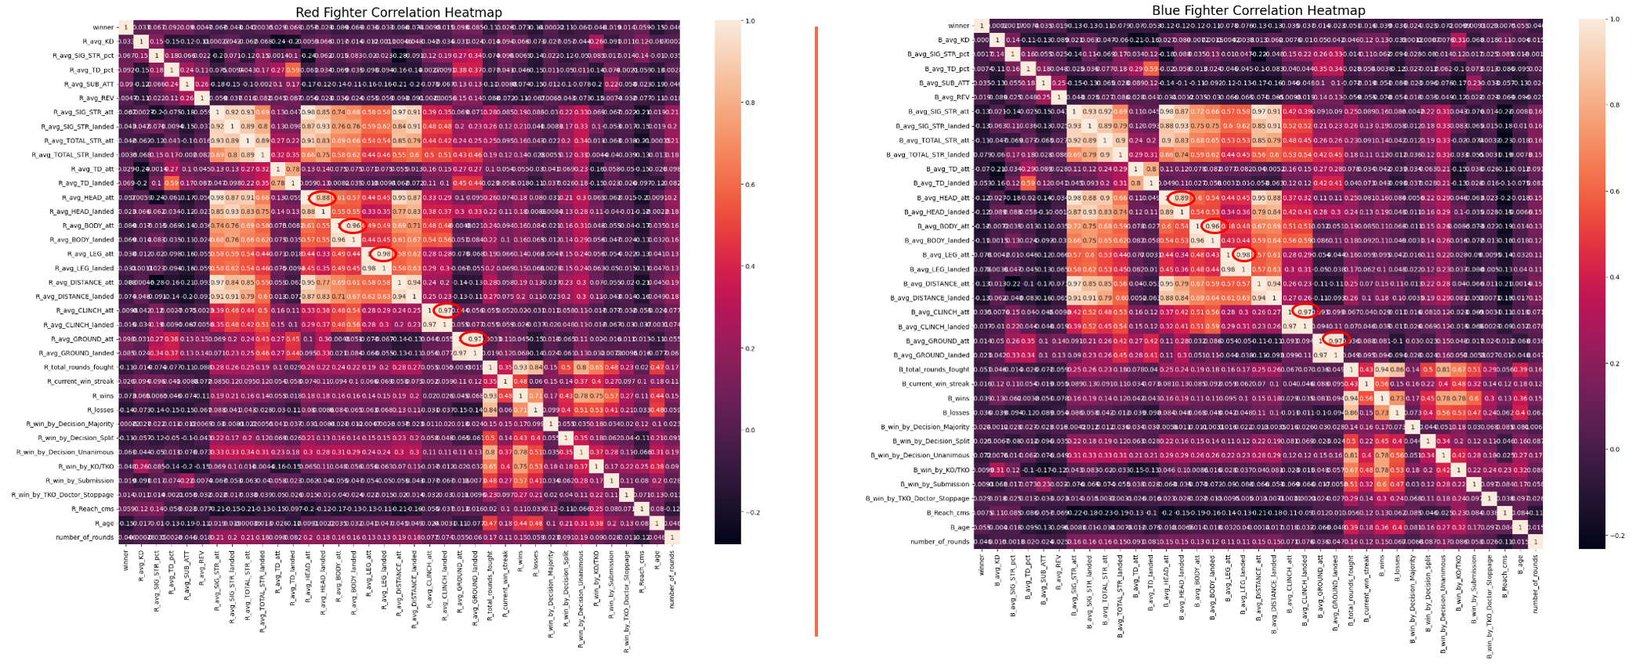
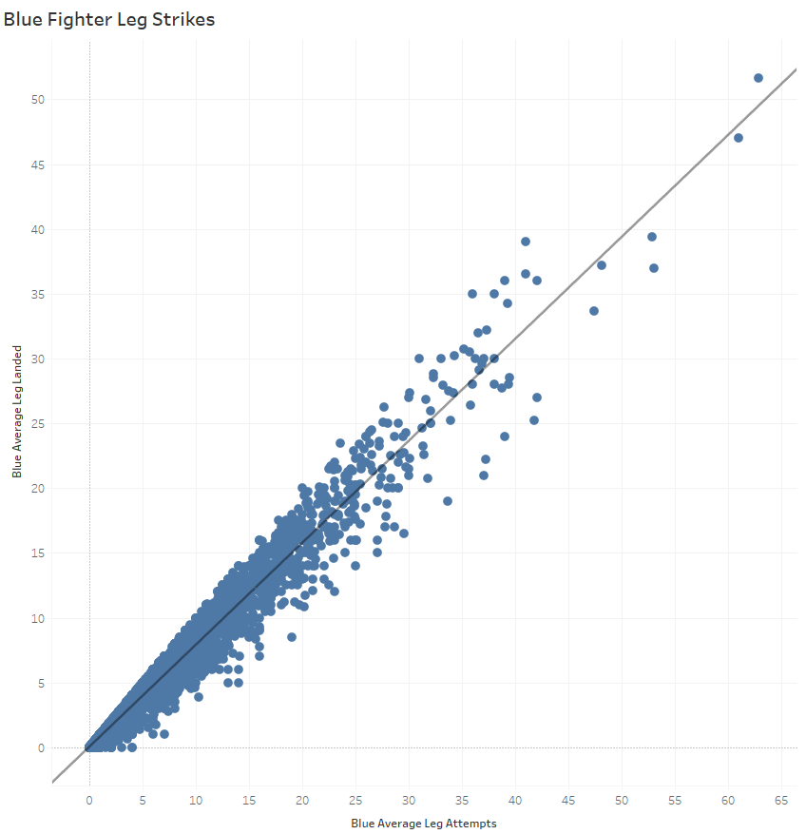
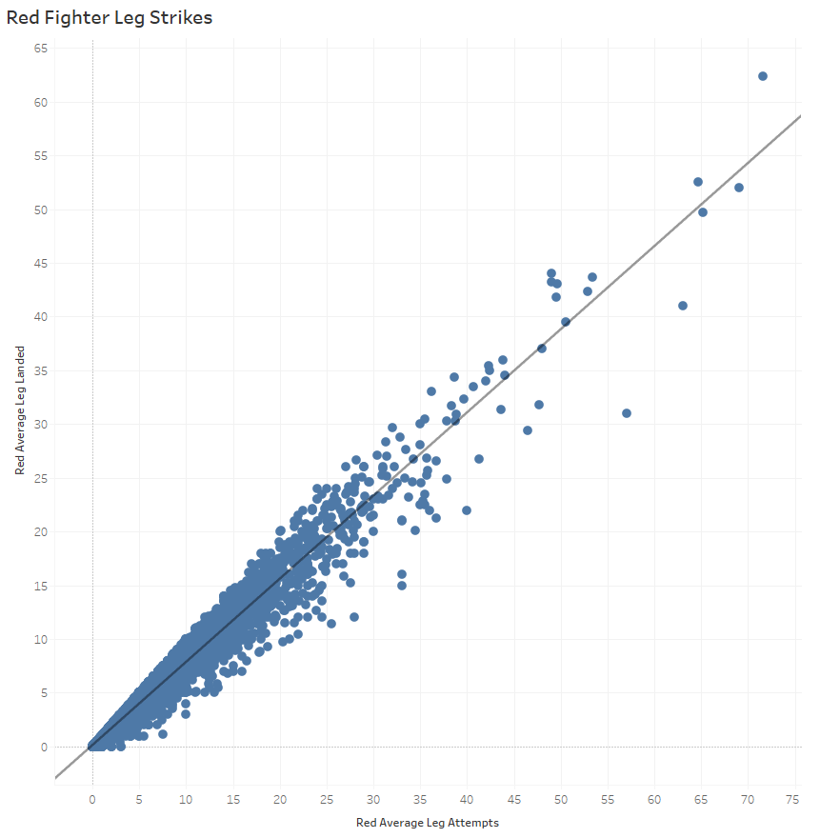
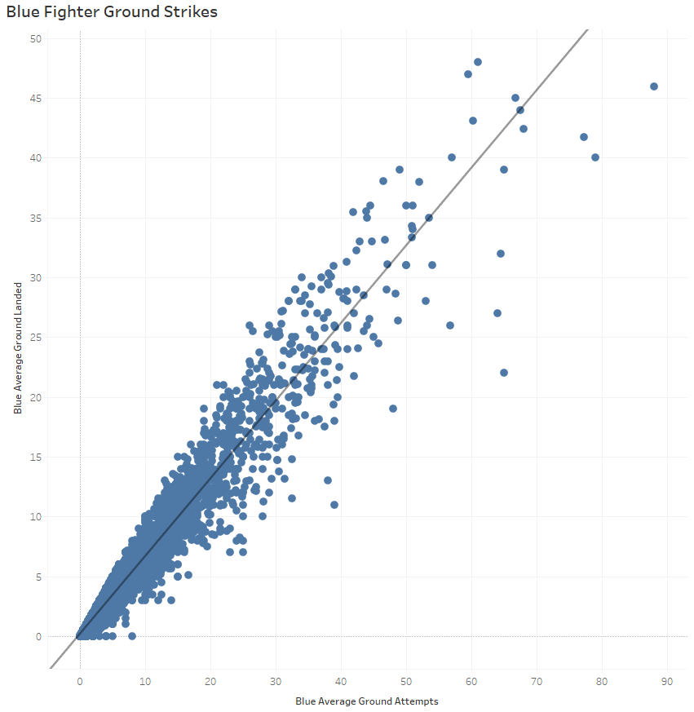
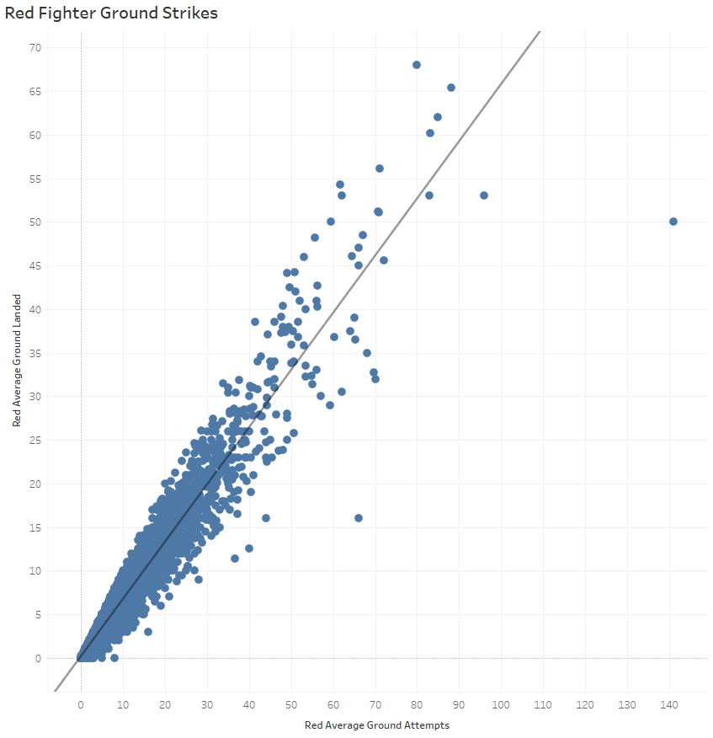
EXPLORATORY VISUAL Analysis
A correlation heatmap was created to find potential relationships between variables and to understand the strength of these relationships.
The analysis reveals a strong positive relationship between the “attempted” strikes and the “landed” strikes from the fighter to the opponent.
For example, the correlation coefficient between leg strikes attempted and leg strikes landed is 0.98, which indicates a strong relationship between the two variables.

Slide 3
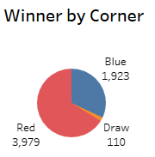
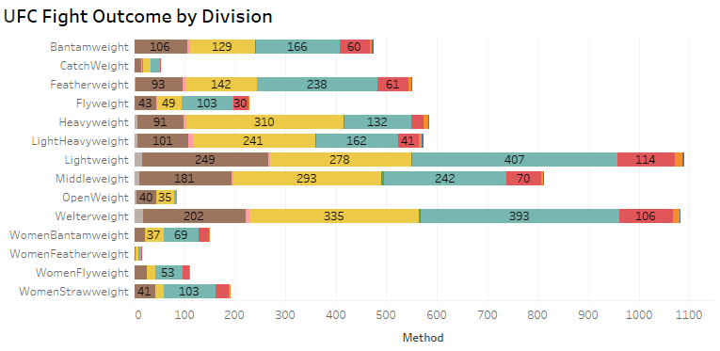
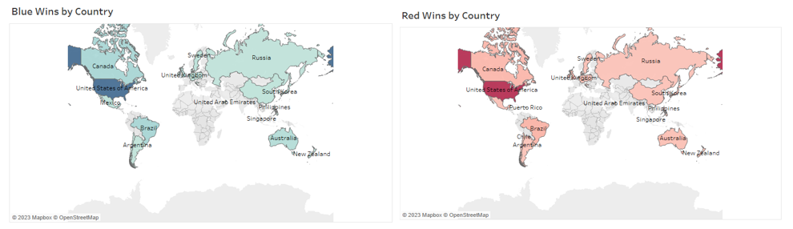
KEY FINDINGS
Geospatial analysis shows us the following countries fighters have the most wins from 1993 to 2021: United States, Brazil, Canada, United Kingdom, and Australia.
Fighters for the most part win in the United States with 2,711 red wins and 1,161 blue wins.
Red has more wins than blue in various countries. It is recommended for future analysis to analyze the data set to determine if there is a significant difference in the number of strikes by a fighter per fight in a different country.
Fighters in the red corner have 2,056 more wins than fighters in the blue corner.
Unanimous Decision and KO/TKO are the top methods for winning a fight in the UFC.
The stacked bar chart above shows Welterweight, Heavyweight, and Middleweight being the top 3 division that generally win fights via KO/TKO.
Lightweight, Welterweight, and Middleweight are the top 3 divisions that generally win fights via Unanimous Decision.
The next step would be to determine if the significant difference in the number of strikes played a factor in winning the fight via KO/TKO or Unanimous Decision.

Slide 4
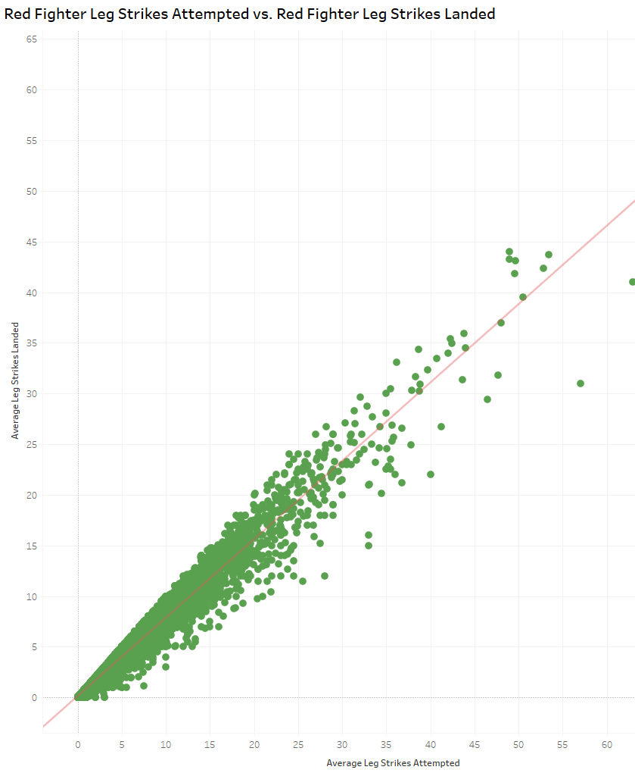
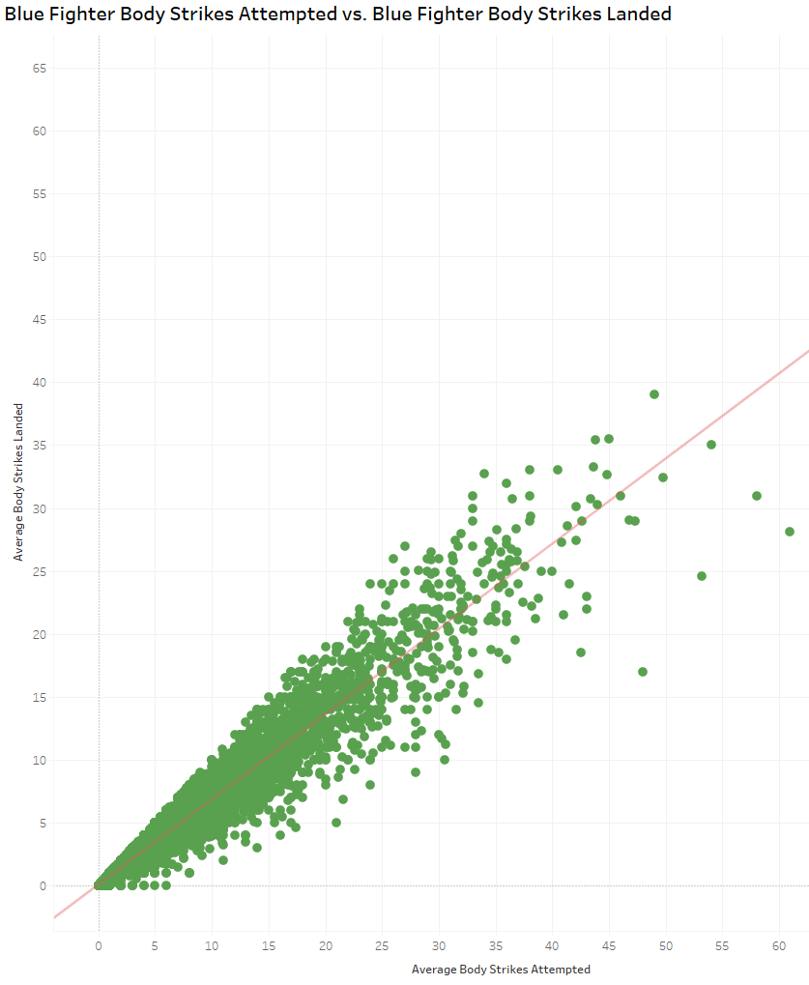
Linear Regression
The linear regression analysis identifies a strong correlation between red fighter leg strikes attempted and red fighter leg strikes landed.
A positive slope indicates a positive relationship. The r-squared value is 0.96, which means that many data points are close to the linear regression function line.
The linear regression analysis identifies a strong correlation between blue fighter body strikes attempted and blue fighter body strikes landed.
The r-squared value is 0.91, which means that many data points are close to the linear regression function line, making it a good fit.

Slide 5


Conclusion and Recommendations
Conclusion
After conducting a linear regression, the results confirm our hypothesis is true.
The top average strikes were head (96%), body (92%), ground (93%), clinch (94%), and head (80% and 77%).
Data set was scraped from the UFC website. Human error can play a factor when performing a task manually.
Collect more up-to-date data, the dataset spans from 1993 to 2021 and having more recently updated data would be beneficial for our analysis.
Collect more data points that could have a potential impact with a fighter's significant number of strikes. (i.e., method, country, and age)
The data spans UFC bouts that have occurred from 1993 to the early months of 2021.
Data Limitation
Next Steps
Investigate more advanced machine learning techniques to assist in exploring our results further.
Analyze the significant difference in the number of strikes between winners and losers in a fight.
View full reports below

